Slide 1

MD5 Algorithm
Presented by :-
1. Suraj Mishra(2023PIS5199)
2.Akash Pramanick(2023PIS5203)
3.Shivam Sharma(2023PIS5206)
4.Atindar Pal Singh(2023PIS5196)
5.Lokeshwara Rao(2023PIS5211)

Slide 2

Introduction
The MD5 cryptographic hash function algorithm converts an input message of any length into a fixed-length message of 16 bytes. The message-digest algorithm is known by its acronym, MD5. With the goal of enhancing security, MD5 was created as an upgrade to MD4. MD5 always produces an output of 128 bits (digest size). Ronald Rivest created MD5 back in 1991.

Slide 3

Primary Purpose
The primary purpose of MD5 is to take an input message (or data) of any length and produce a fixed-size hash value, which is unique to the input data. The algorithm is a one-way function, meaning it is computationally infeasible to reverse the process and obtain the original input from its hash value. This property makes MD5 suitable for tasks like checking data integrity and securely storing passwords.

Slide 4

How MD5 Works ?

Slide 5
Append Padding Bits
In the first step, we add padding bits in the original message in such a way that the total length of the message is 64 bits less than the exact multiple of 512.
Suppose we are given a message of 1000 bits. Now we have to add padding bits to the original message. Here we will add 472 padding bits to the original message. After adding the padding bits the size of the original message/output of the first step will be 1472 i.e. 64 bits less than an exact multiple of 512 (i.e. 512*3 = 1536).
Length(original message + padding bits) = 512 * i – 64 where i = 1,2,3 . . .

Slide 6
Append Length Bits
In this step, we add the length bit in the output of the first step in such a way that the total number of the bits is the perfect multiple of 512. Simply, here we add the 64-bit as a length bit in the output of the first step. i.e. output of first step = 512 * n – 64 length bits = 64.
After adding both we will get 512 * n i.e. the exact multiple of 512.

Slide 7
The MD5 algorithm’s initialization vectors
At the beginning, the initialization vectors are four separate numbers, that outlines the MD5 standard. These are :
A – 01234567
B – 89abcdef
C – fedcba98
D – 76543210
As we progress through the algorithm, these numbers will be replaced by various outputs that we produce through the calculations. However, these four initialization vectors are important for getting us started. All four of them are inputs into the first “16 operations of…” rectangle.

Slide 8
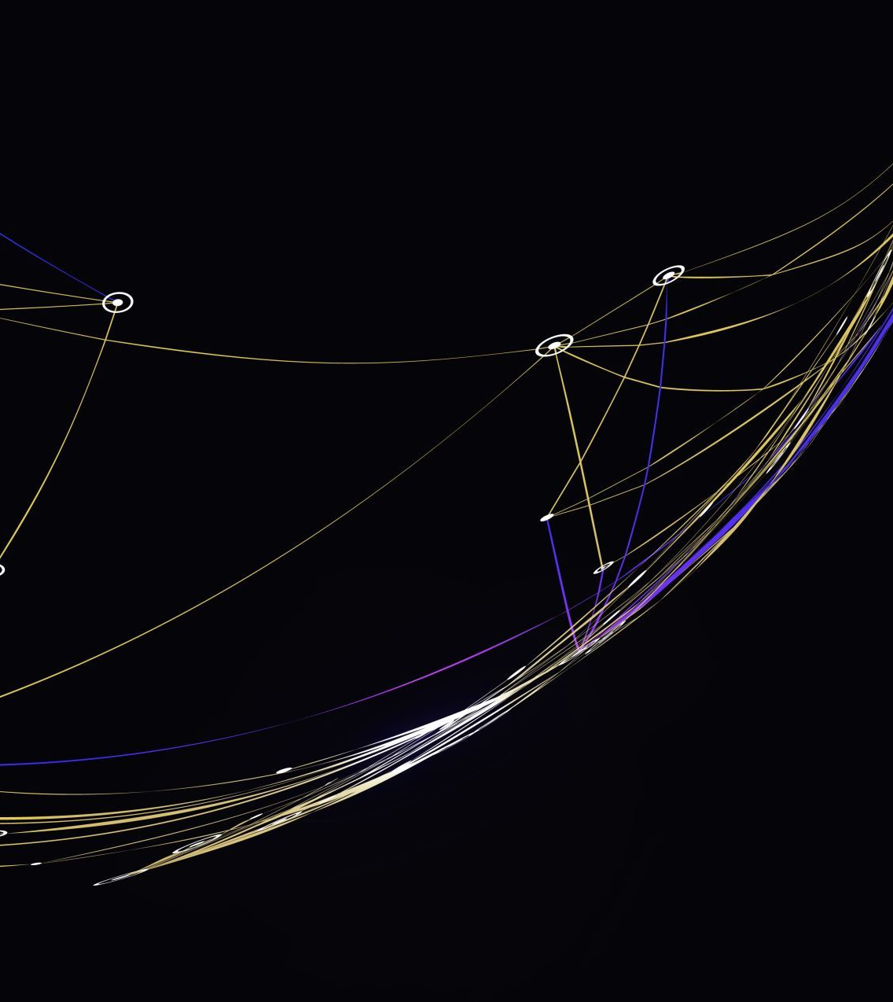
The MD5 F, G, H and I functions :
This is the most important step of the MD5 algorithm.
Here, a total of 64 operations are performed in 4 rounds.
In the 1st round, 16 operations will be performed, 2nd round 16 operations will be performed, 3rd round 16 operations will be performed, and in the 4th round, 16 operations will be performed.
We apply a different function on each round i.e. for the 1st round we apply the 'F' function, for the 2nd 'G' function, 3rd for the 'H' function, and 4th for the 'I' function.

Slide 9

We perform OR, AND, XOR, and NOT (basically these are logic gates) for calculating functions. We use 3 buffers for each function i.e. K, L, M.
F(K,L,M) = (K AND L) OR (NOT K AND M) G(K,L,M) = (K AND L) OR (L AND NOT M) H(K,L,M) = K XOR L XOR M I(K,L,M) = L XOR (K OR NOT M)
After applying the function now we perform an operation on each block. For performing operations we need
add modulo 2³²
M[i] – 32 bit message.
K[i] – 32-bit constant.
<<<n – Left shift by n bits.

Slide 10
Now take input as initialize MD buffer i.e. A, B, C, D. Output of B will be fed in C, C will be fed into D, and D will be fed into A. After doing this now we perform some operations to find the output for A.
In the first step, Outputs of B, C, and D are taken and then the function F is applied to them. We will add modulo 232 bits for the output of this with J.
In the second step, we add the M[i] bit message with the output of the first step.
Then add 32 bits constant i.e. K[i] to the output of the second step.
At last, we do left shift operation by n (can be any value of n) and addition modulo by 232.

Slide 11
After all steps, the result of A will be fed into B. Now same steps will be used for all functions G, H, and I. After performing all 64 operations we will get our message digest.
Output:
After all, rounds have been performed, the buffer A, B, C, and D contains the MD5 output starting with the lower bit A and ending with Higher bits D.

Slide 12
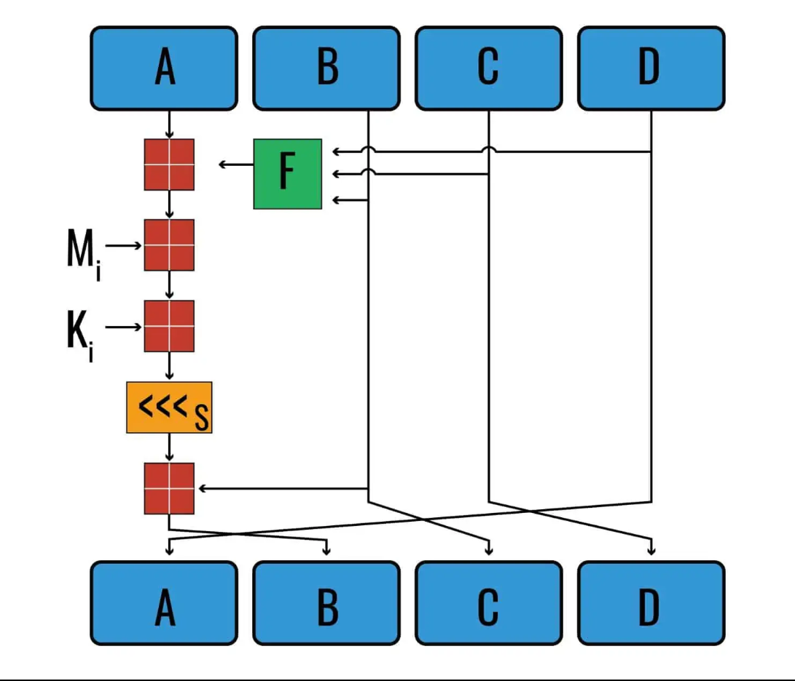
Workflow of Single operation of 1st Round

Slide 13

Getting Confused ?
Let’s see how the MD5 algorithm works through an example

Slide 14
Our input, “They are deterministic”, becomes wildly different when it is put through the MD5 hash function. All we can guarantee is that it will be 128 bits long
When we put “They are deterministic” into an MD5 hash function, the first thing that happens is that it is converted to binary according to ASCII. “They are deterministic” is written in binary as:
01010100 01101000 01100101 01111001 00100000 01100001 01110010 01100101 00100000 01100100 01100101 01110100 01100101 01110010 01101101 01101001 01101110 01101001 01110011 01110100 01101001 01100011

Slide 15
The next step in MD5 is to add padding
Our input is 22 characters long including spaces, and each character is 8 bits long. This means that the input totals 176 bits. With an input of only 176 bits and a 512-bit block that needs to be filled, we need 336 bits of padding to complete the block.
Our input is 22 characters long including spaces, and each character is 8 bits long. This means that the input totals 176 bits. With an input of only 176 bits and a 512-bit block that needs to be filled, we need 336 bits of padding to complete the block.

Slide 16
The reason we only need to pad it up to 448 bits (instead of 512) is because the final 64 bits (512 – 64 = 448) are reserved to display the message’s length in binary. In this case, the number 176 is 10110000 in binary. This forms the very end of the padding scheme, while the preceding 56 bits (64 minus the eight bits that make up 10110000) are all filled up with zeros.
In cases where the message length takes up a greater number of bits, there will be fewer zeros. If the initial input’s length is longer than 64 bits (if it is greater than 264, which equals 18,446,744,073,709,551,616 in decimal), then only the least significant 64 bits are used.

Slide 17
Once the padding scheme is complete, we end up with the following 512-bit string:
01010100 01101000 01100101 01111001 00100000 01100001 01110010 01100101 00100000 01100100 01100101 01110100 01100101 01110010 01101101 01101001 01101110 01101001 01110011 01110100 01101001 01100011 10000000 00000000 00000000 00000000 00000000 00000000 00000000 00000000 00000000 00000000 00000000 00000000 00000000 00000000 00000000 00000000 00000000 00000000 00000000 00000000 00000000 00000000 00000000 00000000 00000000 00000000 00000000 00000000 00000000 00000000 00000000 00000000 00000000 00000000 00000000 00000000 00000000 00000000 00000000 00000000 00000000 10110000

Slide 18
Now our 512-bit M needs to be split into sixteen 32-bit “words”.
Each of these words is assigned its own number, ranging from M0 to M15. In our example, these 16 words are:
M₀ – 01010100 01101000 01100101 01111001 M₁ – 00100000 01100001 01110010 01100101
M₂ – 00100000 01100100 01100101 01110100 M₃ – 01100101 01110010 01101101 01101001
M₄ – 01101110 01101001 01110011 01110100 M₅ – 01101001 01100011 10000000 00000000
M₆ – 00000000 00000000 00000000 00000000 M₇ – 00000000 00000000 00000000 00000000
M₈ – 00000000 00000000 00000000 00000000 M₉ – 00000000 00000000 00000000 00000000
M₁₀ – 00000000 00000000 00000000 00000000 M₁₁ – 00000000 00000000 00000000 00000000
M₁₂ – 00000000 00000000 00000000 00000000 M₁₃ – 00000000 00000000 00000000 00000000
M₁₄ – 00000000 00000000 00000000 00000000 M₁₅ – 00000000 00000000 00000000 10110000

Slide 19

Each of these sixteen values act as inputs to the complex set of operations
Each of these M inputs are used in every single round, they are added in different orders :
In the first round, the M inputs are added into the algorithm sequentially, e.g. M0, M1, M2… M15.
In the second round, the M inputs are added in the following order:
M1, M6, M11, M0, M5, M10, M15, M4, M9, M14, M3, M8, M13, M2, M7, M12
3. In the third round, the M inputs are added in this sequence:
M5, M8, M11, M14, M1, M4, M7, M10, M13, M0, M3, M6, M9, M12, M15, M2
4. In the fourth round, the M inputs are added in the following order:
M0, M7, M14, M5, M12, M3, M10, M1, M8, M15, M6, M13, M4, M11, M2, M9

Slide 20
Now that we have explained our M inputs a little, it’s time to turn our attention to the Initialization Vectors A – 01234567
B – 89abcdef
C – fedcba98
D – 76543210
The MD5 F, G, H and I functions
The first step in the “16 operations of…” rectangle is the function:
F(B, C, D) = (B∧C)∨(¬B∧D)
The F(B, C, D) function is used for the 16 operations of the first round. In the subsequent rounds, its place is taken by these functions:
Round 2: G(B, C, D) = (B∧D)∨(C∧¬D)
Round 3: H(B, C, D) =B⊕C⊕D
Round 4: I(B, C, D) = C⊕(B∨¬D)

Slide 21
The Operations
If you look at the arrow coming out of the F box, you will see that it points into another square that looks kind of like a window. There’s also an arrow from the A going into this box. The box symbol represents modular addition.
(X + Y) mod Z
Where : Z – 100000000 (this is the equivalent to 2³² (which ensures that the result of this equation are no more than eight characters long)

Slide 22
When we zoom in on each “16 operations of…” rectangle, you can see that the arrows from B, C and D point to a box labelled F. This represents function F(B, C, D) – note that in the other three rounds, the F function is replaced by the G, H and I functions, respectively.
If you follow the arrow out of it into the next box, this indicates that the output of F(B, C, D) is added to the initialization vector A, with a special type of addition. In the first operation, initialization vector A’s value is 01234567, but it changes in subsequent operations.
The result moves onto the next box, where it is added to a portion of the input, represented by Mi. After this, a constant, K, is added to the result, using the same special type of addition. The values for K are is derived from the formula:
abs(sin(i+ 1))×2³²

Slide 23

K1 – D76AA478
K2 – E8C7B756
K3 – 242070DB
K4 – C1BDCEEE
K5 – F57COFA
K6 – 4787C62A
K7 – A8304613
K8 – FD469501
K9 – 698098D8
K10 – 8B44F7AF
K11 – FFFF5BB1
K12 – 895CD7BE
K13 – 6B901122
K14 – FD987193
K15 – A679438E
K16 – 49B40821
…..............

Slide 24

One of these K values is used in each of the 64 operations for a 512-bit block. K1 to K16 are used in the first round, K17 to K32 are used in the second round, K33 to K48 are used in the third round, and K49 to K64 are used in the fourth round.
After the K value has been added, the next step is to shift the number of bits to the left by a predefined amount, Si. We will explain how this works further on in the article. The amount that each bit is shifted varies according to which operation the MD5 algorithm is up to. Each operation has a preset number of shifts, and the operations use them in sequential order (e.g. S1, S2, S3, etc.). The S values are:

Slide 25
Round one
1
S1, S5, S9, S13 – 7
S2, S6, S10, S14 – 12
S3, S7, S11, S15 – 17
S4, S8, S12, S16, – 22
Round two
2
S17, S21, S25, S29 – 5
S18, S22, S26, S30 – 9
S19, S23, S27, S31 – 14
S20, S24, S28, S32 – 20
Round three
3
S33, S37, S41, S45 – 4
S34, S38, S42, S46 – 11
S35, S39, S43, S47 – 16
S36, S40, S44, S48 – 13
Round four
4
S49, S53, S57, S61 – 6
S50, S54, S58, S62 – 10
S51, S55, S59, S63 – 15
S52, S56, S60, S64 – 21

Slide 26
After the shift has been made, the result of all of these calculations is added to the value for initialization vector B. Initially, it’s 89abcdef, but it changes in subsequent operations.
The output of this value becomes the initialization vector for B in the next operation. The initialization vectors B, C and D are shuffled over one space to the right, so that B becomes C, C becomes D, and D becomes A in the next operation.

Slide 27
Four rounds of 16 operations
This process goes in a loop for 16 operations. Each time, the inputs stipulated above are used for their respective operation. The 17th operation is the start of the second round, and the process continues similarly, except the G function is used instead.
Things change again by the 33rd operation, when the H function is used for the duration of the third round. The fourth round begins at the 49th operation, and the I function is used instead.
Upon conclusion of the fourth round and its 64th operation, the outputs are added to the original initialization vectors that we listed above. The result of this calculation is the final MD5 hash of our input.

Slide 28
The hash of an MD5 hash function
Because we are only computing the hash for a single 512-bit block of data, we have all of the information we need for the final hash. It’s simply a concatenation (this is just a fancy word that means we put the numbers together) of these latest values for A, B, C and D:
Hash = ABCD
Therefore, the hash of our original message of “They are deterministic” is:
H (They are deterministic) = 61f1141806fbee528a1a2bf59437d949

Slide 29

Application Of MD5 Algorithm:
We use message digest to verify the integrity of files/ authenticates files.
MD5 was used for data security and encryption.
It is used to Digest the message of any size and also used for Password verification.
For Game Boards and Graphics.

Slide 30

Advantages of MD5 Algorithm:
MD5 is faster and simple to understand.
MD5 algorithm generates a strong password in 16 bytes format. All developers like web developers etc. use the MD5 algorithm to secure the password of users.
To integrate the MD5 algorithm, relatively low memory is necessary.
It is very easy and faster to generate a digest message of the original message.

Slide 31

Disadvantages of MD5 Algorithm:
MD5 generates the same hash function for different inputs.
MD5 provides poor security over SHA1.
MD5 has been considered an insecure algorithm. So now we are using SHA256 instead of MD5
MD5 is neither a symmetric nor asymmetric algorithm.

Slide 32

THANK YOU

